Slide 1

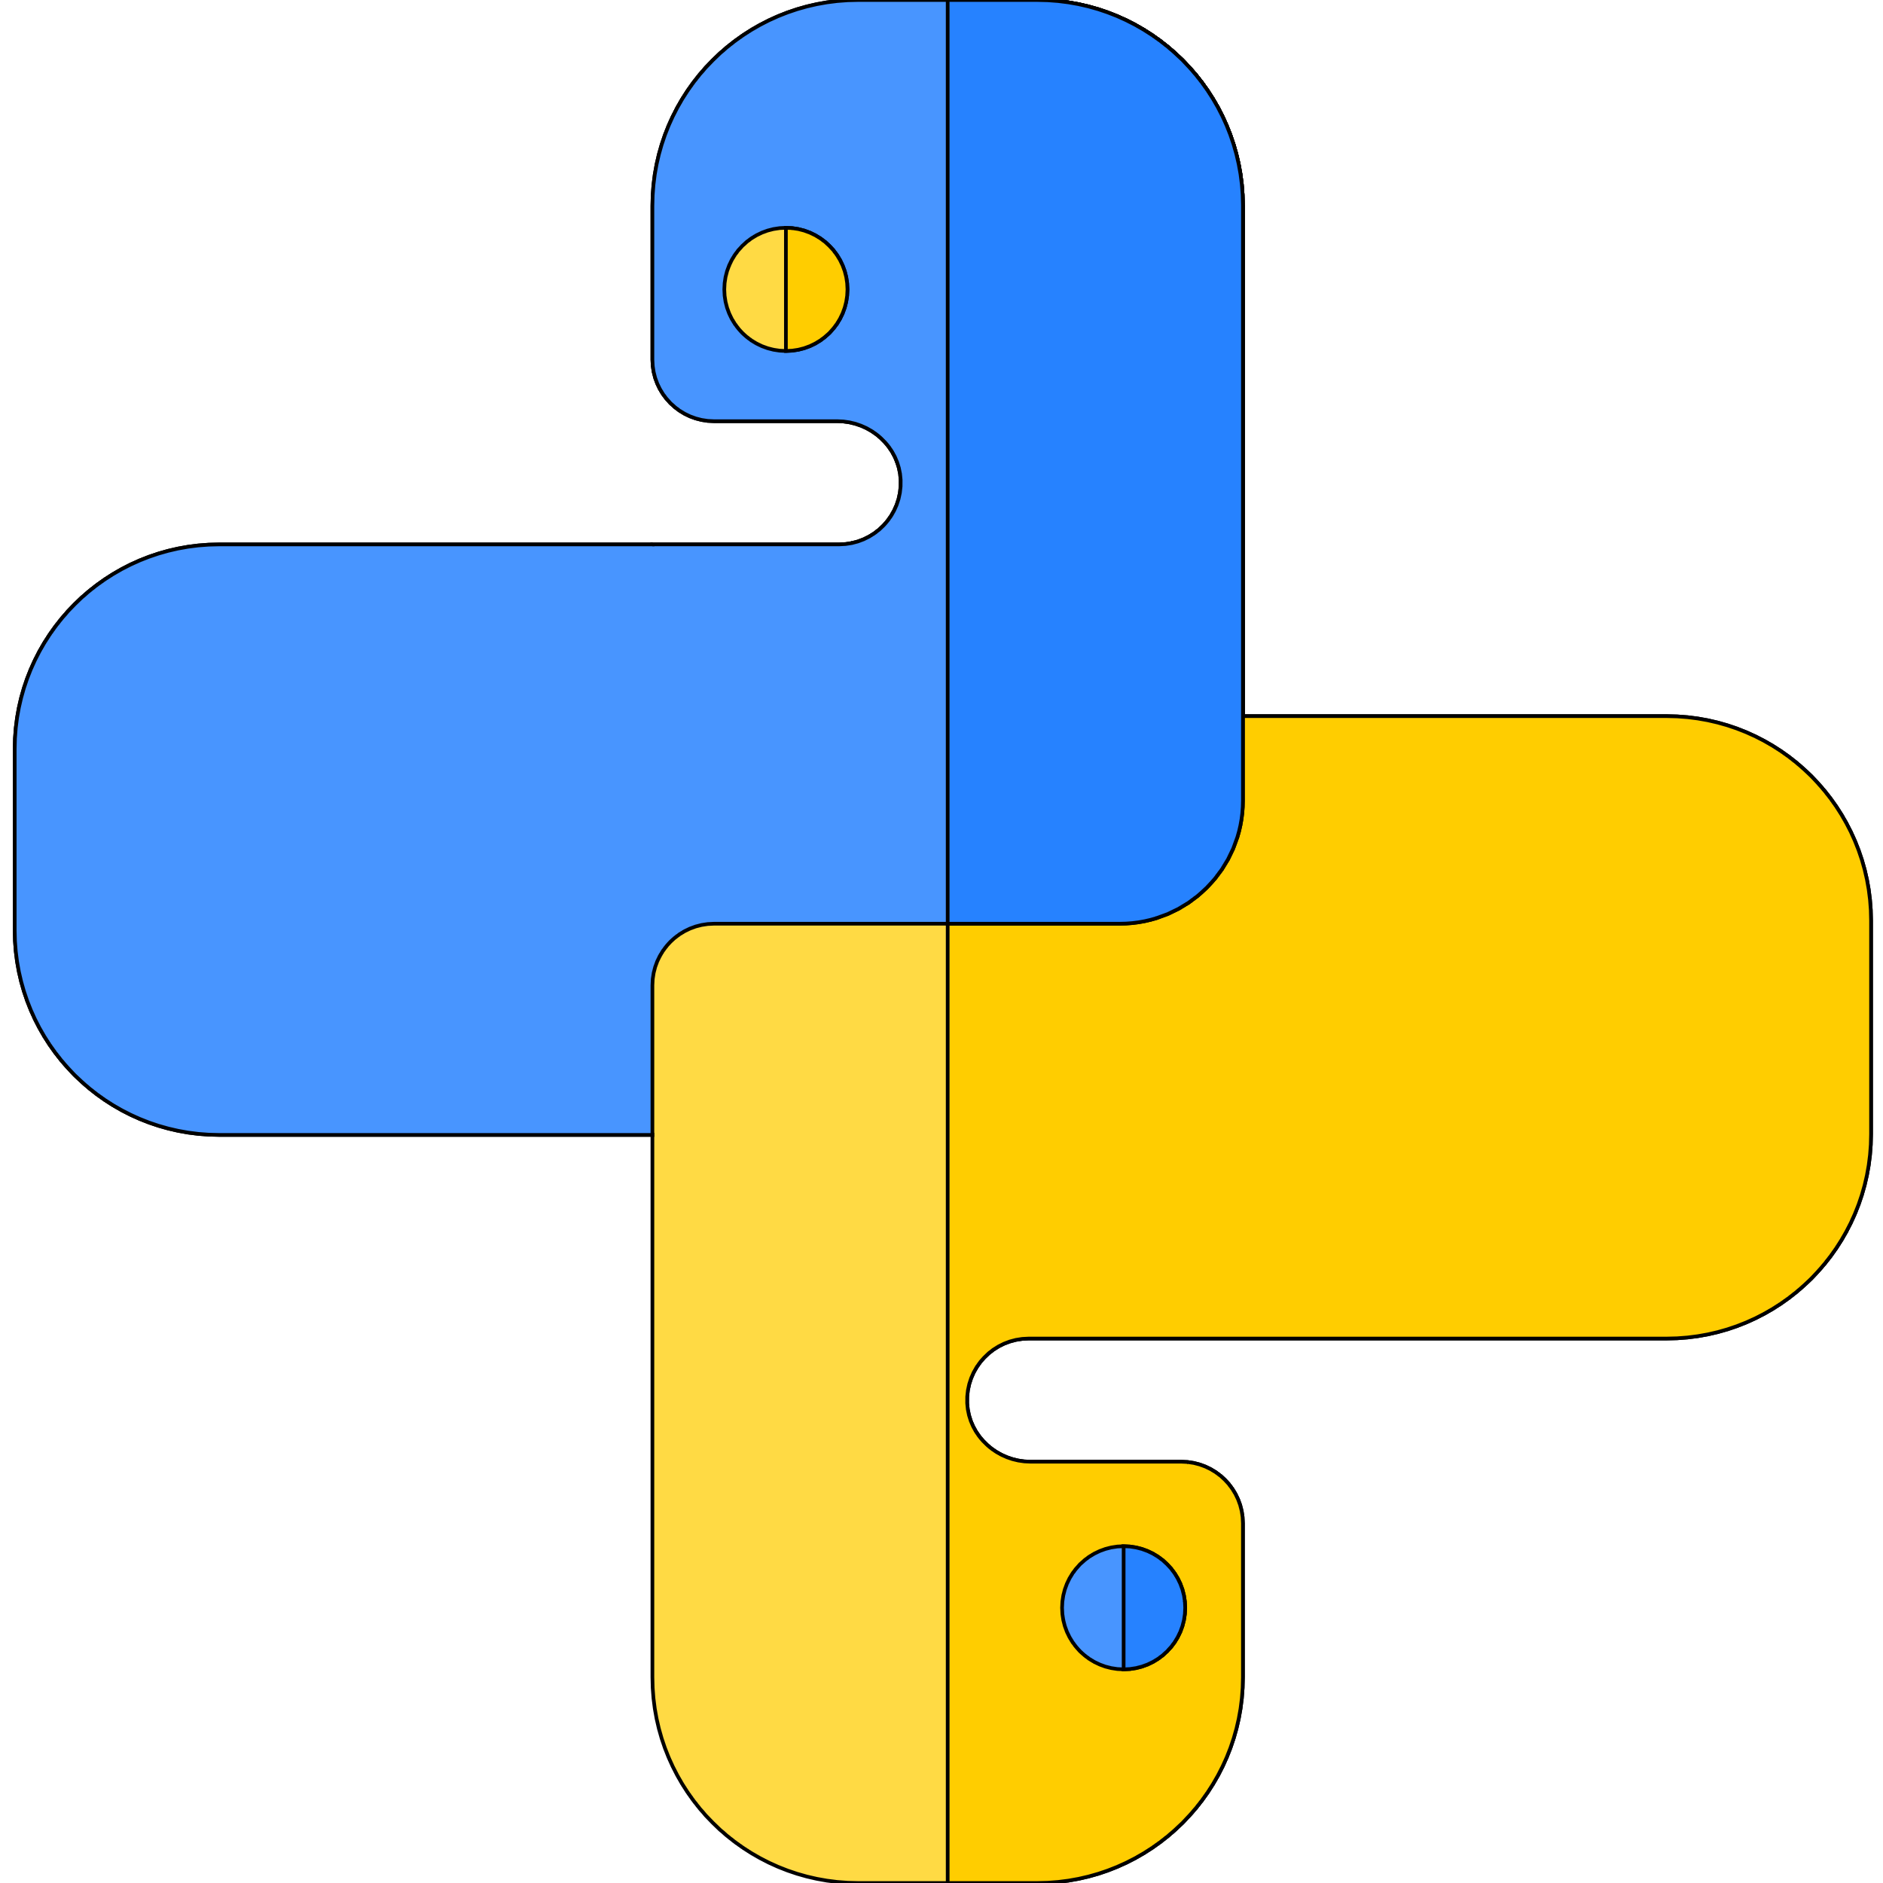


Data types and Sequences
Author : Aman Singh
Lecture 7

Slide 2
Today’s Agenda
What is data type?
Built-in data types in python.
Sequences
Slicing

Slide 3


Data Types
?
Let’s start…

Slide 4
Data types…
Data types are classification of data items.
It represents the kind of value and tells us what operations can be performed on a particular data.
Everything in python is an object so, data types are actually classes and variables are instance (object) of these classes.
Data types in Python: 1. Numbers (integer, Float, Complex) 2. Sequences (string, list, Tuples, range) 3. Boolean 4. Sets (set, frozen set) 4. Dictionary

Slide 5
What is Sequence?
?
Let’s start…

Slide 6
Sequences…
A sequence is a collection of object ordered by their position.
In python there are three basic sequences : 1. Lists 2. Tuples 3. Range Objects
Strings are special type of sequence that can only store characters and they have special notations.
However, all the sequence operation described here can be used on strings.
Sequence index starts at 0.

Slide 7
Slicing…
Objects can be accessed from left to right with positive index and right to left using negative index.
We can access multiple objects using by colon operator: # seq[3:6] # seq[:] #seq[4:] #seq[:-5]

Slide 8

Thanks!
Any questions?
Just Comment down below.
If you like this video don’t forget to Subscribe and Share
You can find me at singhaman11415@gmail.com

